Slide 1
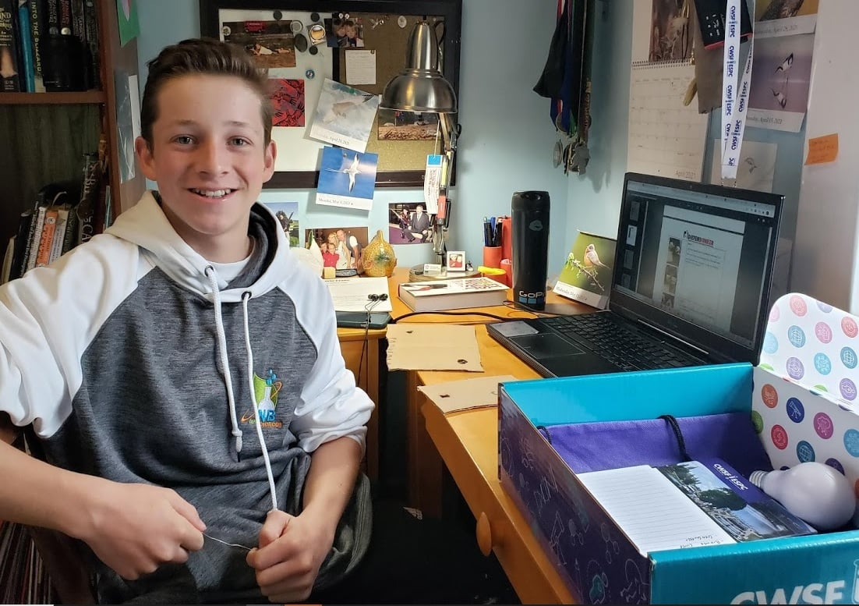
Anglophone School Districts Virtual Template for Regional STEM Fairs

Slide 2
Virtual NB Regional STEM Fair ProjectBoard Template
This template mirrors the Sections and Descriptors that will be used on the ProjectBoard site.
The purpose of this template is to help students build/construct a presentation that will be uploaded to the ProjectBoard site for the NB Regional STEM Fairs. These sections are the same as those on the digital platform, allowing students to cut and paste their work onto the site.

Slide 3
Project Types
DISCOVERY
Devise and carry out experimental research or synthesize and analyze data from a variety of sources.
INNOVATION
Develop and evaluate new devices, models, theorems, physical theories, techniques, or methods.

Slide 4
For Inspiration CWSF Categories (Canada-Wide Science Fair)
Agriculture, Fisheries and Food: my project helps ensure food security, sustainability or competitiveness in agriculture, fisheries or food production.
Curiosity and Ingenuity: my project helps improve our understanding or address a problem in an area of STEM not covered by the other challenges.
Digital Technology: my project helps improve our quality of life or transform existing products and service through digital devices, methods or systems
Disease and Illness: my project helps enhance our diagnosis, treatment or understanding of disease, or the management of physics or mental illness.
Energy: my project helps improve our use of the current energy sources, enable the transition to alternative energy sources, or reduce our energy footprint
Environment and Climate Change: my project helps ensure the quality of water, air , soil or the diversity of living thing, or manage the impact of climate change
Health and Wellness: my project helps prevent disease or promote physical, social, emotional, spiritual, environmental, occupational, or intellectual well-being
Natural Resources: my project help ensure the sustainable management, use, reuse or recycling of Earth's finite or renewable natural resources.

Slide 5
Summary: MAXIMUM 150 WORDS AND 1 IMAGE
This is the first section that people will see after they click on your project. Replace text with your project title.
The summary text should be written for a middle school (age 11-13) audience – avoid scientific jargon or acronyms. Keep it concise to hold their attention. Ask a family member or friend to read it:
Does it interest them?
Is it easy to understand?
A recommended format would be:
One or two sentences to introduce the question or problem and catch the reader’s attention.
Two or three sentences describing what you did.
One or two sentences summarizing the main results or explaining your solution.
One or two sentences to describe the importance of your findings or innovation.
You will be able to add an image that represents your project.

Slide 6
Communication - Video
Tell us about your project in 1 minute or less!
This is your opportunity to talk to your audience face-to-face.
Introduce yourself and tell us what got you interested in the question or problem, what you did and what it means. Focus on the main parts of your project:
Why?
How?
What?
Remember, one minute is a very short time! Prepare a simple script and time yourself before recording. Speak clearly and slowly. Show off your prototype, equipment or use a model.
Upload your video to YouTube or directly to the site. We encourage you to set the privacy to “Unlisted.” If you set it to “Private”, people won’t be able to watch your video.
Use the link button in the image area above to add the link to your video.

Slide 7
Initiate and Plan: Why?
Tell us your story!
You can use project sections, such as purpose, hypothesis and background information or a more narrative approach.
Some ideas you could include:
Why did you do this project?
What or who inspired you to do this project?
What question were you trying to answer or what problem were you trying to solve?
Who could benefit from your project?
How can it make the world a better place?
MAXIMUM 250 WORDS AND 5 IMAGES/FIGURES

Slide 8
Perform and Record - How?
How did you perform your experiment or develop your solution?
You can use project sections, such as materials, methods, procedures, design process and testing procedure or a more narrative approach. Figures, photos, or prototype sketches can be used to show what you did.
Some ideas you could include:
How did you do your background research?
How did you identify relevant and trustworthy sources of information?
What was your experiment or design process?
How did you design and test your solution or prototype?
What materials did you use?
How did you collect your data?
How many samples did you test?
How did you control the variables?
MAXIMUM 300 WORDS AND 5 IMAGES/FIGURES

Slide 9
Analyze and Interpret: What?
Tell us your results! What did you find out?
You can use project sections, such as results, tables and graphs or a more narrative approach.
Here are ideas that you could include in this section:
What are the main results or findings of your project?
How does your prototype work?
Discuss your results.
If you used statistics, explain why you chose the methods you used?
Show your results in graphical form – only include graphs or figures that summarize your data and support your conclusion.
It’s not necessary to show all the data you collected. Please, don't include every graph or table!
MAXIMUM 500 WORDS AND 5 IMAGES/FIGURES

Slide 10
Analyze and Interpret: So What?
Tell us why your results are important and what they mean.
You can use project sections, such as discussion and conclusion or a more narrative approach.
Here are ideas that you could include in this section:
What are the conclusions you can draw from your results?
What did you learn from your results?
MAXIMUM 250 WORDS AND 5 IMAGES

Slide 11
Analyze and Interpret: What’s next?
Tell us how you could extend your project.
You can use project sections, such as further research and future improvements or a more narrative approach.
Here are ideas that you could include in this section:
What could you have done differently?
How could you improve your project?
What are the next steps?
MAXIMUM 100 WORDS AND 5 IMAGES

Slide 12
References
Tell us where you got your information and ideas!
All ideas, thoughts, data or statements that are not uniquely your own should be referenced. We encourage the use of APA formatting for all your references. Here are a few examples:
Journal articles:
Denisov, I. G., & Sligar, S. G. (2017). Nanodiscs in membrane biochemistry and biophysics. Chemical Reviews, 117(6), 4669-4713.
Books:
Eby, G. N. (2016). Principles of environmental geochemistry. Waveland Press.
Webpages:
Property and Environment Research Center. (2007, Winter). Less is more when it comes to packaging. Retrieved from http://perc.org/articles/less-more-when-it-comes-packaging
Books/reviews with individual authored chapters:
Molina, J. R., Yang, P., Cassivi, S. D., Schild, S. E., & Adjei, A. A. (2008, May). Non-small cell lung cancer: epidemiology, risk factors, treatment, and survivorship. In Mayo Clinic Proceedings (Vol. 83, No. 5, pp. 584-594). Elsevier.
Proceedings, conference abstracts:
Abu-Jbara, A., & Radev, D. (2012, June). Reference scope identification in citing sentences. In Proceedings of the 2012 Conference of the North American Chapter of the Association for Computational Linguistics: Human Language Technologies (pp. 80-90). Association for Computational Linguistics.

Slide 13
Register for the NB Regional STEM Fair
For information, contact NB Regional STEM Coordinator:
Becky.Geneau@scienceeast.nb.ca
Who’s eligible?
North-West New Brunswick Regional STEM Fair
Participating students from ASD-North and ASD-West (projects MUST have qualified from the District Fairs / Showcases), private schools, and home school.
Registration - Qualified District Student Projects only
https://youthscience.ca/north-west-new-brunswick/
Registration opens March 26 and closes April 5, 2022.
Project Judging will be conducted April 12, 2022.
Be prepared to use Microsoft Teams for Project Presentations.

